Slide 1
CS 116
OBJECT ORIENTED PROGRAMMING II
LECTURE 4
GEORGE KOUTSOGIANNAKIS
Copyright: 2016 Illinois Institute of Technology/George Koutsogiannakis

Slide 2
OOP Review
In previous lecture we discussed:
  Declaring and Instantiating Arrays
  Entering Array Elements
  Accessing Array Elements
  Aggregate Array Operations
  Arrays of Objects.
  Creating Packages

Slide 3
Arrays – Single Dimension
Topics
Copying Array Values.
Enumerations.
Searching Arrays.
Selection Sort .

Slide 4
Copying Array Values
Example
This code copies the values of all elements in an array named cellBills to an array named billsBackup, both of which have previously been instantiated with the same length:
for ( int i = 0; i < cellBills.length; i++ )
{
billsBackup[i] = cellBills[i];
}
The effect of this for loop is shown on the next slide.
See Example 8.7 CopyingArrayElements.java

Slide 5
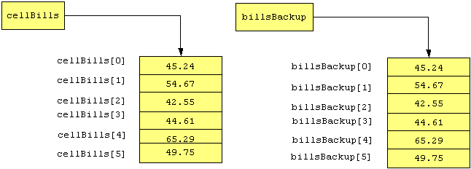
Copying Array Values
(cont’d)
A separate copy of the array has been created.

Slide 6
Changing an Array's Size
An array's length instance variable is constant
  that is, arrays are assigned a constant size when they are instantiated
To expand an array while maintaining its original values:
  Instantiate an array with the new size and a
  temporary name
  Copy the original elements to the new array
  Point the original array reference to the new array
  Assign a null value to the temporary array reference

Slide 7
Comparing Arrays for Equality
To compare whether the elements of two arrays are equal:
  Determine if both arrays have the same length
  Compare each element in the first array with the corresponding element in the second array
To do this, we'll use a flag variable and a for loop.

Slide 8
Comparing cellBills1 to cellBills2
boolean isEqual = true; // flag variable
if ( cellBills1.length != cellBills2.length )
isEqual = false; // sizes are different
else
{
for ( int i = 0;
i < cellBills1.length && isEqual; i++ )
{
if ( Math.abs( cellBills1[i] - cellBills2[i] )
> 0.001 )
isEqual = false; // elements are not equal
}
}
See Example 8.8 ComparingArrays.java

Slide 9
enum Types
We discussed enumerations earlier in a previous lecture. Here is a review again:
  Enumerated Types are classes with special properties.
  They have a finite number of instances (as for example Days in previous slide).

Slide 10
Useful enum Methods
Return value | Method name and argument list
int | compareTo( Enum eObj ) compares two enum objects and returns a negative number if this object is less than the argument, a positive number if this object is greater than the argument, and 0 if the two objects are equal.
int | ordinal( ) returns the numeric value of the enum object. By default, the value of the first object in the list is 0, the value of the second object is 1, and so on.
boolean | equals( Object eObj ) returns true if this object is equal to the argument eObj; returns false otherwise
String | toString( ) returns the name of the enum constant

Slide 11
Example enum
enum PersonType { ADULT_MALE, CHILD_MALE, ADULT_FEMALE, CHILD_FEMALE };
public class Persons
{
PersonType pt;
String firstName;
static int id;
int currentid;
public Persons()
{
firstName="John";
id++;
currentid=id;
}
public void setPersonType(PersonType pertyp)
{
this.pt=pertyp;
}
public PersonType getPersonType()
{
return pt;
}
}

Slide 12
Example enum
public class PersonsClient
{
public static void main(String[] args)
{
Persons p1=new Persons();
Persons p2=new Persons();
p1.setPersonType(PersonType.ADULT_FEMALE);
p2.setPersonType(PersonType.CHILD_MALE);
System.out.println("p1 is of person type:"+" "+p1.getPersonType());
System.out.println("p2 is of person type:"+" "+p2.getPersonType());
}
}

Slide 13
Example enum
  ---------- Output ----------
  p1 is of person type: ADULT_FEMALE
  p2 is of person type: CHILD_MALE
  -----------------------------------
Notice that enumeration is a class:
  It can be included in the same file as the class that is using it (the service class) or
  It can be by itself in its own file in which case you have to compile it.

Slide 14
Algorithms
An algorithm is any set of detailed instructions which results in a predictable end-state from a known beginning.
  We can program the instructions to achieve a specific result
  For example, we may want to develop a technique for searching arrays to find if a specific piece of data is store din the array and in which index is stored.
  Another example is the case where we want to store the values stored in an array in some predefined order.

Slide 15
Sequential Search
A Sequential Search can be used to determine if a specific value (the search key) is in an array.
Approach
Start with the first element and compare each element to the search key:
  If found, return the index of the element that contains the search key
  If not found, return -1
    Because -1 is not a valid index, this is a good return value to indicate that the search key was not found in the array

Slide 16
Code to Perform a Sequential Search
Suppose we want to search array: int numbers[] for a number of value key:
public int sequentialSearch ( int key )
{
for ( int i = 0; i < numbers.length; i++ )
{
if ( numbers[i] == key )
return i;
}
return -1;
}

Slide 17
Example
Suppose numbers={ 3, 5, 1, 6, 10, 2 } and key=6
i=0 is 6==3 ? No
i=1 is 6==5 ? No
i=2 is 6==1 ? No
i=3 is 6==6 ? Yes return index=3 (found it)
i=4 is 6==10? No
i=2 is 6==2 ? No
Notice that the algorithm keeps going even after the key is found until all elements of the array are compared.

Slide 18
Revised Code for more efficient search
public int sequentialSearch( int key )
{
for ( int i = 0; numbers[i] <= key
&& i < numbers.length; i++ )
{
if ( numbers[i] == key )
return i;
}
return –1; // end of array reached without finding key or
// an element larger than the key was found
}
Notice that the for loop stops when the key is found because of the condition numbers[i] <= key !

Slide 19
Sorting an Array
When an array's elements are in random order, our Sequential Search method needs to look at every element in the array before discovering that the search key is not in the array.
This is inefficient; the larger the array, the more inefficient a Sequential Search becomes.
We could simplify the search by arranging the elements in numeric order, which is called sorting the array. Once the array is sorted, we can use various search algorithms to speed up a search.

Slide 20
Sequential Search of a Sorted Array
When the array is sorted, we can implement a more efficient algorithm for a sequential search.
If the search key is not in the array, we can detect that condition when we find a value that is higher than the search key.
All elements past that position will be greater than the value of that element, and therefore, greater than the search key.

Slide 21
Selection Sort
Suppose we want to sort from smallest to largest element in the array.
In a Selection Sort, we make one pass through the array and select the largest element in the array and place it at the end of the array.
Then we make another pass through the array up to index=length-2 this time and select the next-largest element and put it in the next-to-last position in the array, and so on.
To do this, we consider the unsorted portion of the array as a subarray.
  We repeatedly select the largest value in the current subarray and move it to the end of the subarray, then consider a new subarray by eliminating the elements that are in their sorted locations.
  We continue until the subarray has only one element. At that time, the array is sorted.

Slide 22
The Selection Sort Algorithm
To sort an array with n elements in ascending order:
1. Consider the n elements as a subarray with m = n elements
2. Find the index of the largest value in this subarray
3. Swap the values of the element with the largest value and the element in the last position in the subarray
4. Consider a new subarray of m = m - 1 elements by eliminating the last element in the previous subarray
5. Repeat steps 2 through 4 until m = 1

Slide 23
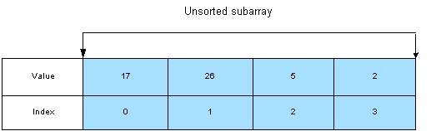
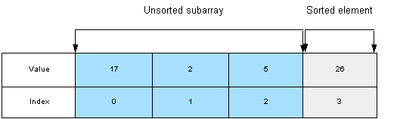
Selection Sort Example
In the beginning, the entire array is the unsorted subarray:
We swap the largest element with the last element:

Slide 24
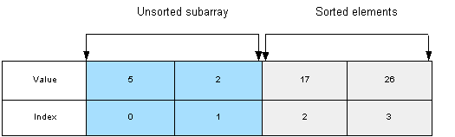
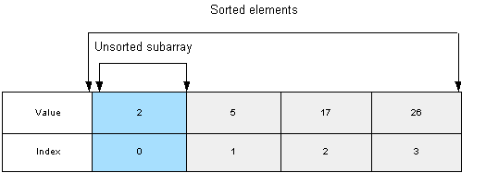
Selection Sort Example (cont’d)
Again, we swap the largest element and the last element:
When there is only one unsorted element, the array is completely sorted:

Slide 25
Sorting Arrays of Objects
In arrays of objects, the array elements are object references.
Thus, to sort an array of objects, we need to sort the data of the objects.
Usually, one of the instance variables of the object acts as a sort key.
  For example, in an email object, the sort key might be the date received.

Slide 26
Code for Selection Sort Declarations
import java.util.*;
import java.io.*;
public class SelectionSort
{
public static void main(String[] args)
{
int i=0;
int count=0;
int index=0;
int array []=new int[10];
int temp;
int max;
int subarraylength=0;
//notice that we have assumed that there are 10 numbers in the file.
//otherwise we have to count the numbers in the file and set the size of //the array accordingly.

Slide 27
Code for Selection Sort– Read the numbers from a file and place in array
Notice that we have assumed that we know the size of the file (the number of numbers)!!!
try
{
File file=new File(args[0]);
Scanner scanner=new Scanner(file);
i=scanner.nextInt();
array[count]=i; //first element at index 0 has been entered.
while(scanner.hasNext())
{
count++;
i=scanner.nextInt();
array[count]=i;
}
}
catch (IOException e){System.out.println(“Error reading the file”); }

Slide 28
Code for Selection Sort– Algorithm
//we are going to go through the array size-1 times.
for (int j=0; j<=array.length-1; j++ )
{
subarraylength=array.length-j;
//find index of largest element in subarray
index=0;
for (int k=1; k<subarraylength; k++)
{
if (array[k] > array[index])
{
index=k;
}
}

Slide 29
Code for Selection Sort– Algorithm
// Now swap array elements
temp=array[index];
array[index]=array[array.length-j-1];
array[array.length-j-1]=temp;
}//end top for
//Read the array now. The elements should be sorted.
for (int g=0; g<array.length ; g++)
{
System.out.println(+array[g]);
}
}//end main
}// end of class

Slide 30
Sorting Objects By a Field’s Value
Change the comparison from the previous slides so that it is now:
If(array[k].getFieldName()>array[index].getFieldName())
…………………………………..
Be careful with the swapping part of the algorithm also..
  temp variable will have to be of the class type that is stored in the array
  i.e VehicleA temp;

Slide 31
Number of Comparisons
Suppose the unsorted array size= n
First pass (comparisons) is n-1
Next pass is n-2
Next pass is n-3 and so on.
Total number of passes (comparisons) is:
n ( n-1) / 2
Thus if n=10
numbers of passes: 10*(10-1)/2 = 45

